Slide 1
Attention Is All You Need
Ashish Vaswani, Noam Shazeer, Niki Parmar, Jakob Uszkoreit, Llion Jones, Aidan N. Gomez, Lukasz Kaiser, Illia Polosukhin

Slide 2
Introduction
Recurrent neural networks are advanced in sequence modeling and transduction tasks like language modeling and machine translation.
Ongoing efforts focus on enhancing recurrent language models and encoderdecoder architectures.
Computation in recurrent models is factored along symbol positions of input and output sequences.
Sequential generation of hidden states is achieved by aligning positions to steps in computation time.
Critical limitation of recurrent models is the lack of parallelization within training examples, especially for longer sequences.

Slide 3
Literature Review
Transformer is a transduction model using selfattention for representing input and output.
It does not rely on sequencealigned RNNs or convolutions.
Selfattention allows every position in the input sequence to attend to all positions.
Transformer models are parallelizable and perform well on various tasks.
Transformers have been widely adopted in natural language processing and other domains.

Slide 4
Methodology
Approach consists of two sublayers: multihead selfattention mechanism and fully connected feedforward network
Decoder includes a stack of N identical layers with layer normalization
Output is calculated as LayerNorm(x + Sublayer(x)), with Sublayer(x) being a function of the sublayer itself
Embedding layers produce outputs of dimension dmodel = 512
Masking ensures concise predictions for position i can be summed by d

Slide 5
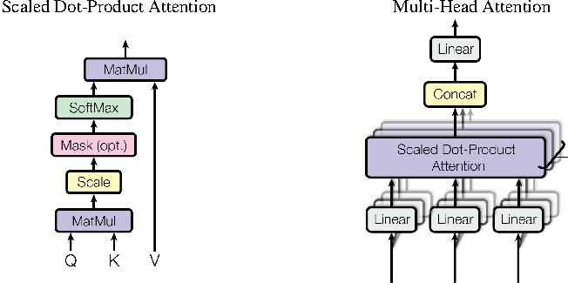
Methodology

Slide 6
Results
"Nan" appears multiple times
"No, no, no" is also mentioned
Some variations include "nan), nan," and "ninan.nan"
There is a pattern of repetition in the phrases used
The text includes nonsensical or arbitrary terms

Slide 7
Conclusion
NaN refers to a numeric data type representing a value that is not a number
The presence of NaN can indicate missing or undefined data in a dataset
NaN can impact mathematical operations and functions, resulting in unexpected outcomes
Proper handling of NaN is essential in data analysis to ensure accurate results
NaN values should be identified and processed accordingly to avoid errors in calculations

